Slide 1
Hotel Spa RESERVATION System
Presented by:
Andres, Giomar T. Bongat, Gene Carlo A. Garinga, Antonio Salvador S. Mandac, Edward Joseph R. Ngceen, Gabriel Angelo A. Orosco, Caryl Johanan C.

Slide 2
INTRODUCTION Project Context
The Asmara Spa's booking process, according to their client, is all manually performed. The researcher's task is to create a reservation system for the spa that will automate the process of booking a reservation and include an online reservation system for potential customers who are looking to avail the different services offered at the Asmara Spa via the internet.

Slide 3
INTRODUCTION Purpose and Description
The purpose of this project is mainly to provide the a reservation system that will automate most of the processes in their working environment. With manual work processes, many errors can occur that will waste time, lose efficiency, and possibly drop customer satisfaction rates which will, in return, reduce the amount of customers of the spa.
The reservation system will show the availability of the spa's services and the available schedules . The system will have a web interface for users who want to book an appointment but isn't a guest checked-in at the hotel.

Slide 4
INTRODUCTION Objectives
General Objective: To create and implement an efficient reservation system for the client that automates their work processes. The system's efficiency is measured through the reports generated as it shows how many bookings are made daily.
Specific Objectives:
To address the mistakes that occur from doing manual work processes.
To eliminate instances of conflict in booking appointments.
To reduce the amount of time and resources needed in the booking process.
To generate a report that would show spa trends that shows how many bookings are made per day, what is the most demanded service, and what are the peak hours and days.

Slide 5
INTRODUCTION Scope and Limitations
The proposed system will be handling reservation requests from hotel guests, walk-in customers, and online submissions.
The system automatically assigns each customers' reservation to the spa's treatment rooms and should completely eliminate reservations with overlapping time slots.
Handles the automation of assigning staff members to their reservations, but still manually inform them of the reservation they were assigned to.
This system doesn’t cover payment transactions.
Doesn't cover the staff's attendance as it is handled by the HR department.
Assumptions:
Price of the service will depend on the service's duration.
Staff members are well-rounded and has their own fixed schedule to provide the services.

Slide 6
REVIEW OF RELATED LITERATURE /SYSTEMS
 | Online Booking | Employee Management | Customer Database | Generates Reports and Analytics | Integration into Hotel Systems
Zensoft Spa & Salon Management System |  | ✓ | ✓ | ✓
Agilysis |  | ✓ |  | ✓
Envision Spa System | ✓ |  |  | ✓
Mindbody Spa System | ✓ | ✓ | ✓ | ✓
Salonlite | ✓ | ✓ | ✓ | ✓
Springer-Miller Systems: SpaSoft | ✓ | ✓ | ✓ | ✓ | ✓
Common Features

Slide 7
REVIEW OF RELATED LITERATURE /SYSTEMS Features to be Adapted
Customer Database (Zensoft)
Storing of guest profiles, identifying new and returning customers.
Integration into Hotel Systems (Springer-Miller)
Obtain the guests checked-in at the hotel and their information for an easier system flow.
Online Booking (Salonlite)
The system is constantly running 24/7 for it to be able to still accept reservations during off-hours.
Reports (All systems)
Daily reports which shows the trends on that certain day.

Slide 8
TECHNICAL BACKGROUND Programming Language
The program is built purely in the platform Yii 2, an open source PHP framework. The database is built on MySQL.
PHP - is a server-side scripting language designed primarily for web development but also used as a general-purpose programming language.

Slide 9
TECHNICAL BACKGROUND Resource Requirements
Hardware Requirements
CPU – Intel Pentium Core 2 Duo
Disk Space – 1 GB
RAM – 1 GB
Software Requirements
Web Service – Nginx Server or Apache Server
Database Server - MySQL
Browser – Internet Explorer, Microsoft Edge, Mozilla Firefox, Google Chrome or Safari
Operating System – Windows, Linux or MAC OSX
Human Resource Requirements
Receptionist - will be the one to use the system in the front desk.

Slide 10
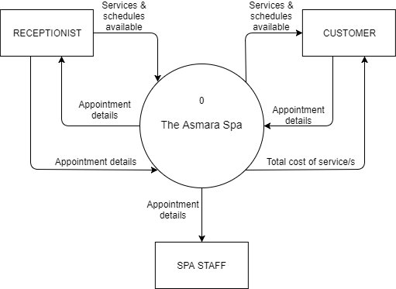
Data Flow Diagram for the Existing System
Context Diagram

Slide 11
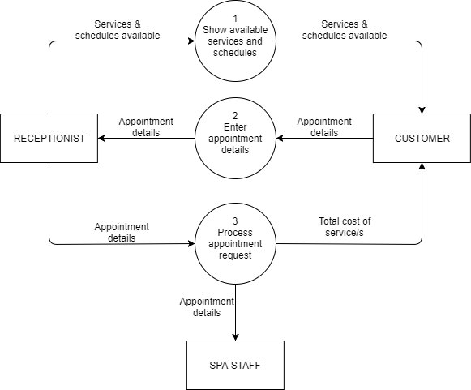
Level 0

Slide 12
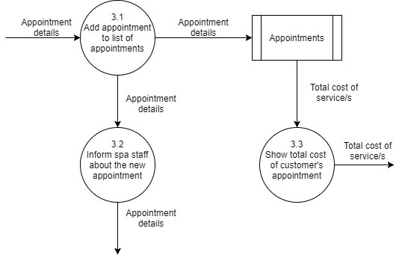
Level 1 DFD for Process #3

Slide 13
THE EXISTING SYSTEM Problem Areas
The problem of the existing system includes manual work and overlapping of appointments. Manual work may take more time to process the services that the customer wants. Booking appointments of the existing system may overlap and cause errors.

Slide 14
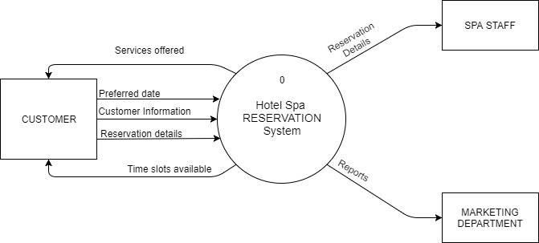
Data Flow Diagram for the Proposed System
Context Diagram

Slide 15
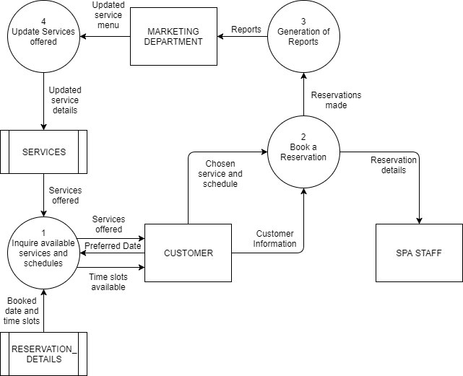
Level 0 DFD

Slide 16
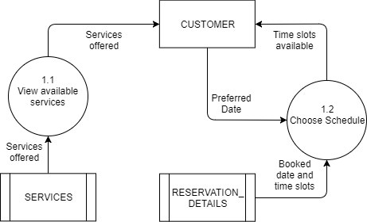
Level 1 DFD for Process 1

Slide 17
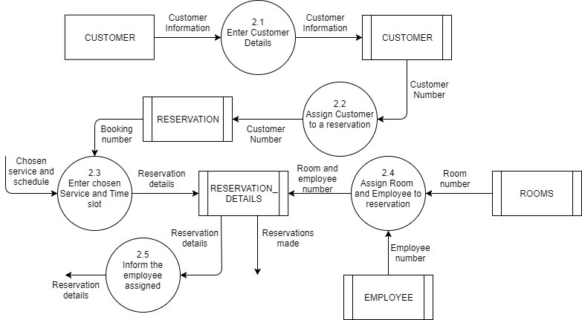
Level 1 DFD for Process 2

Slide 18
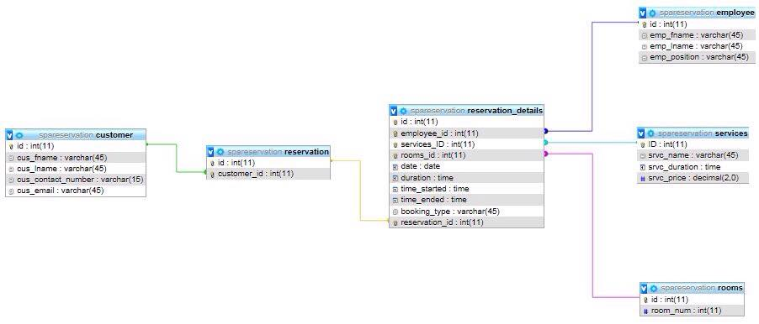
Entity Relationship Diagram

Slide 19
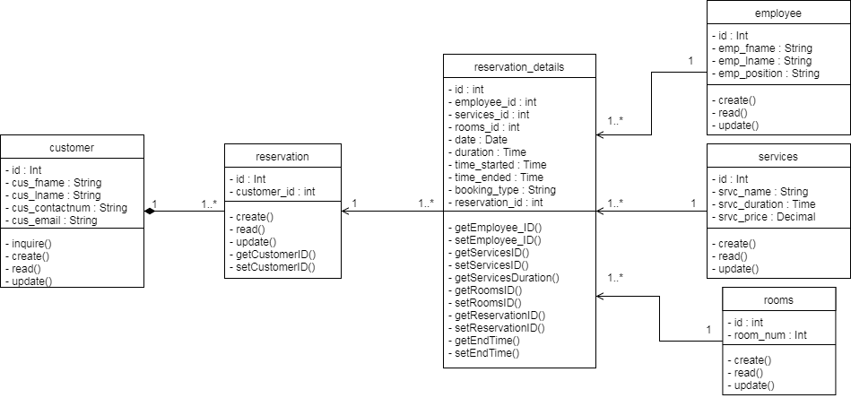
Class Diagram

Slide 20
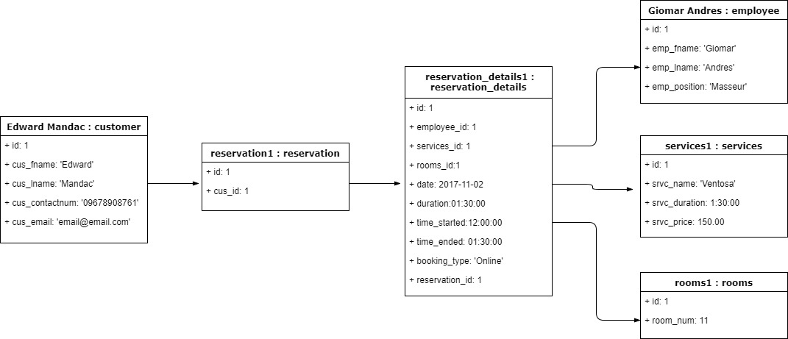
Object Diagram

Slide 21
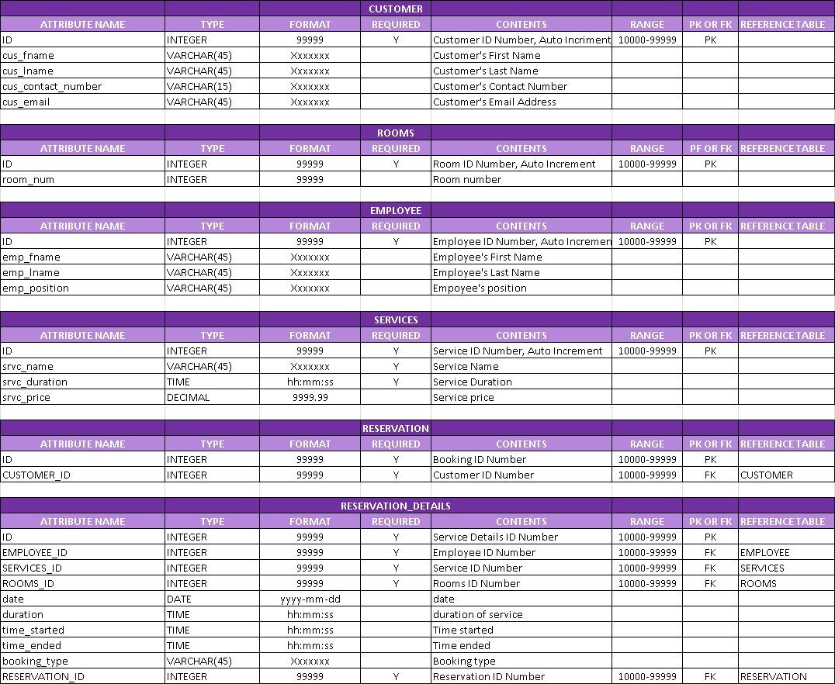
Data Dictionary

Slide 22
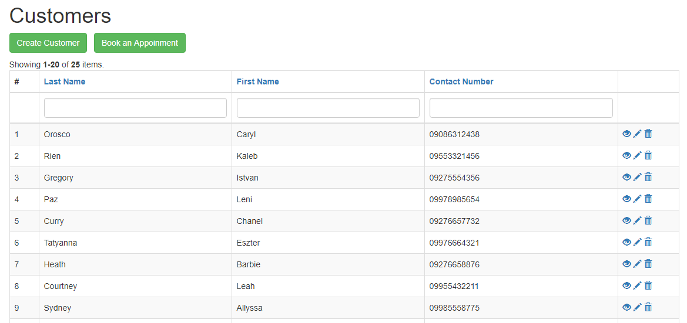
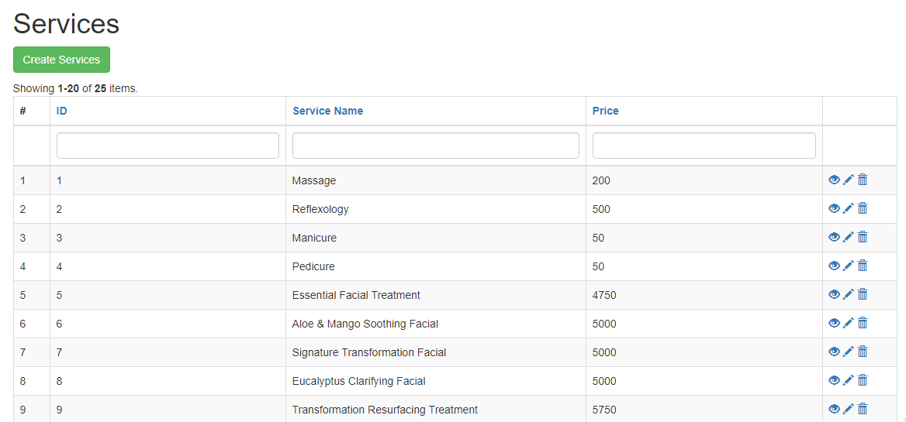
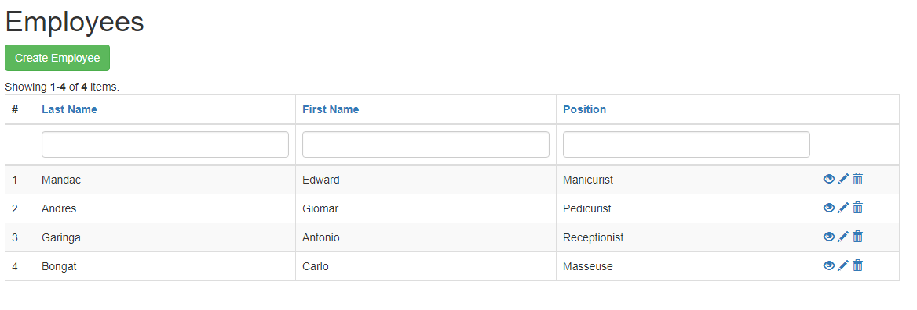
Tables/Files Layout

Slide 23
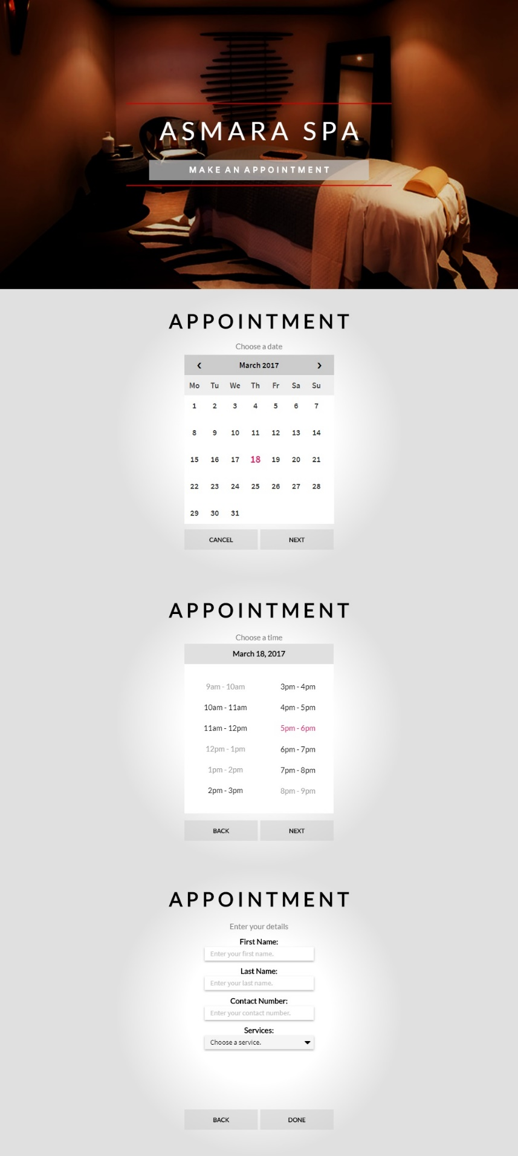
Screen Layout/Specification

Slide 24
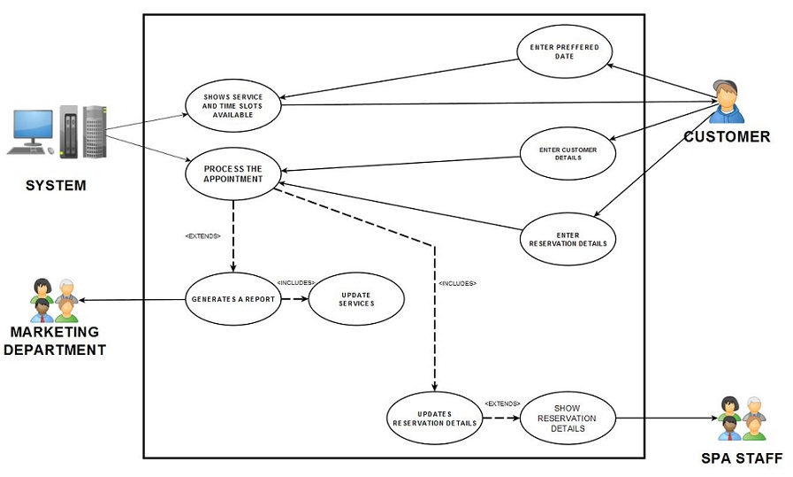
Use Case Diagram

Slide 25
USE CASE | Reservation
ACTOR | Customer
DESCRIPTION | Process of customer reservation
SUCCESSFUL COMPLETION | Customer enters their preferred date. Customer enters their details Customer enters their reservation details Once the reservation details are processed, the customer will wait until their reservation schedule comes.
ALTERNATIVE | 1a. Customer is a walk-in guest and wants the service at the exact moment.
PRE-CONDITION | Spa must be online
ASSUMPTIONS | Reservation details were successfully sent.
Fully Dressed Use Case

Slide 26
USE CASE | Spa Service
ACTOR | Spa Staff
DESCRIPTION | How the staff are assigned
SUCCESSFUL COMPLETION | The spa staff is assigned to a reservation The spa staff waits for the schedule of reservation
ALTERNATIVE | 1a. Spa staff handles the walk-in customer
PRE-CONDITION | Each spa staff is able to perform any type of service that the spa offers.
ASSUMPTIONS | Reservation details are successfully received.
Fully Dressed Use Case

Slide 27
USE CASE | Report Collection
ACTOR | Marketing Department
DESCRIPTION | How reports are acquired
SUCCESSFUL COMPLETION | Marketing head will wait for the daily report Changes in services will be made by the Marketing head if needed
ALTERNATIVE
PRE-CONDITION | Marketing department has received the report
ASSUMPTIONS | The Marketing head updates the services by the report
Fully Dressed Use Case

Slide 28
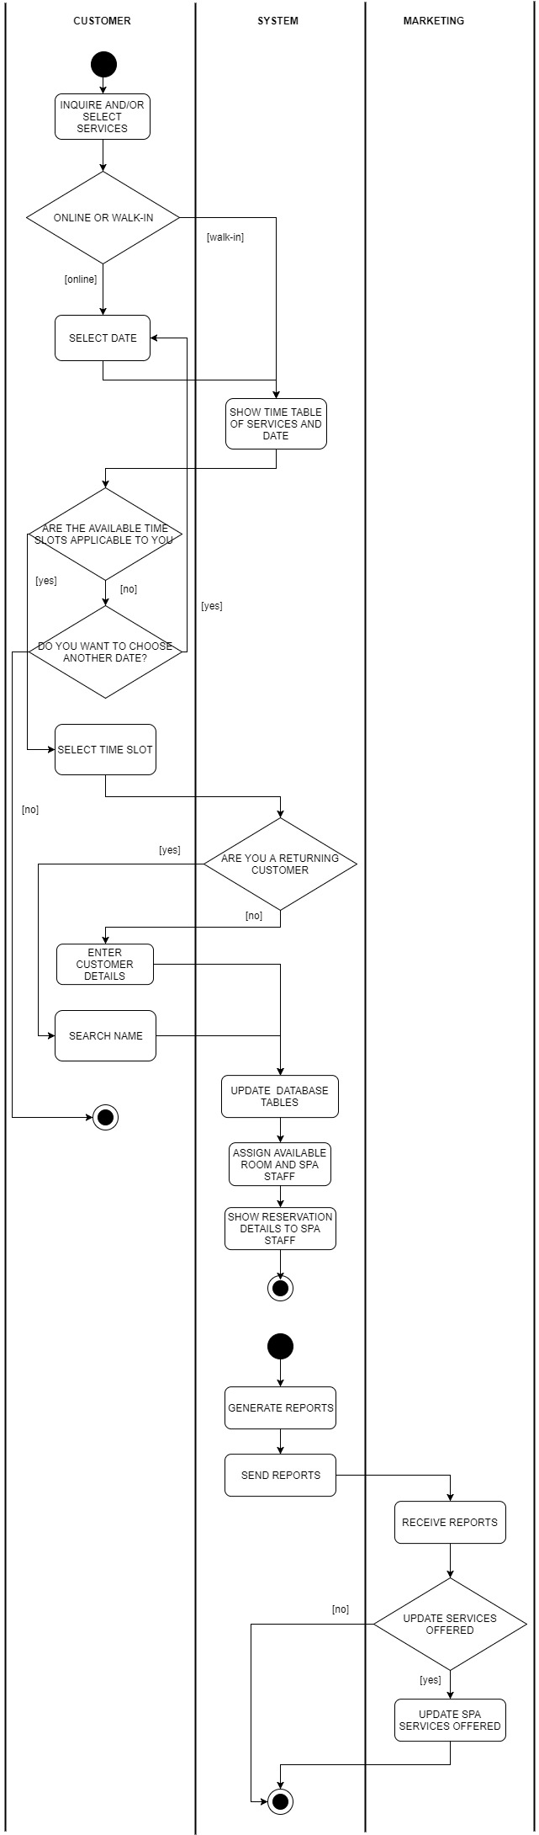
Activity Diagram

Slide 29
Activity Diagram

Slide 30
Activity Diagram

Slide 31
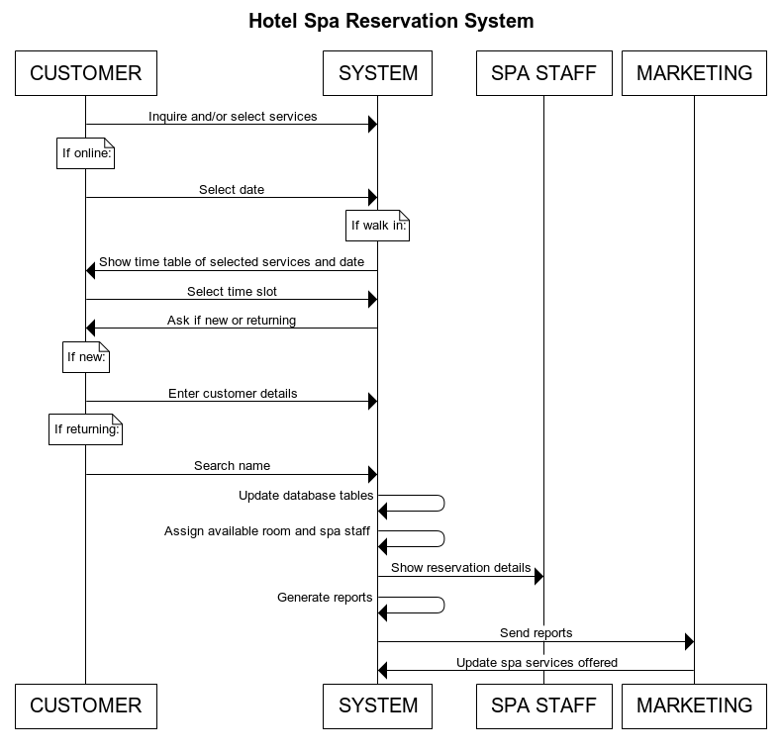
Sequence Diagram

Slide 32
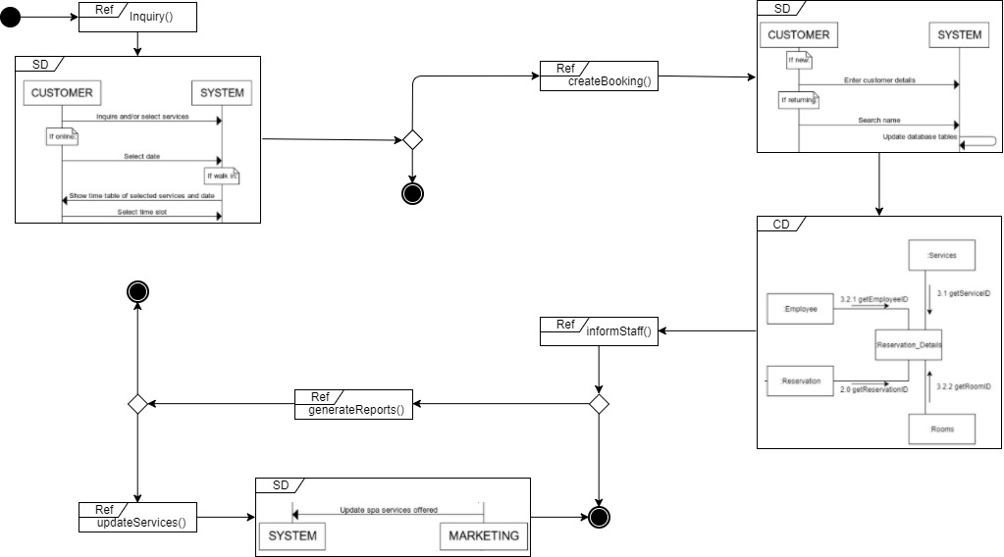
Interaction Overview Diagram

Slide 33
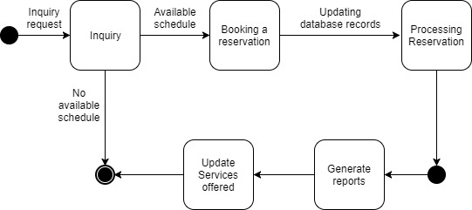
State Machine Diagram

Slide 34
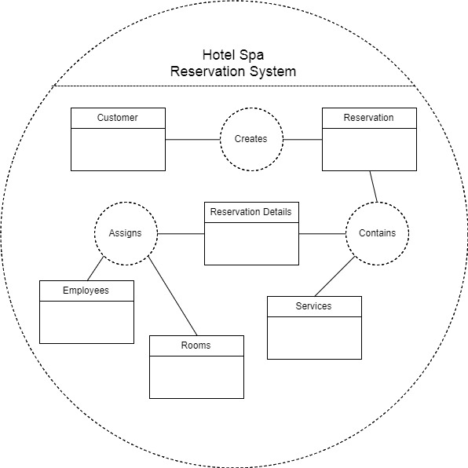
Composite Structure Diagram

Slide 35
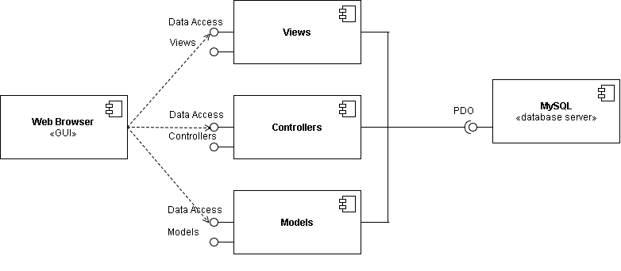
Component Diagram

Slide 36
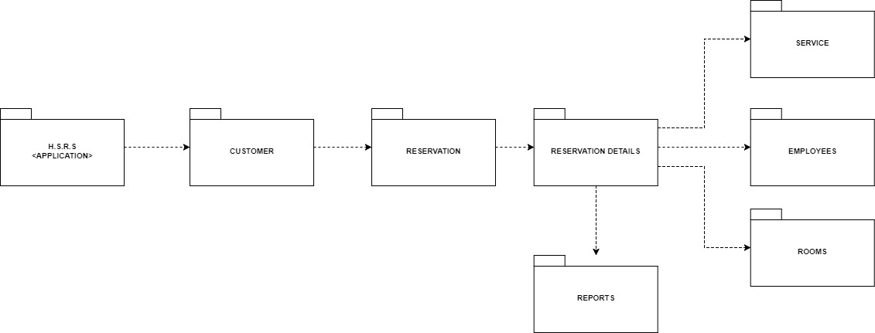
Package Diagram

Slide 37
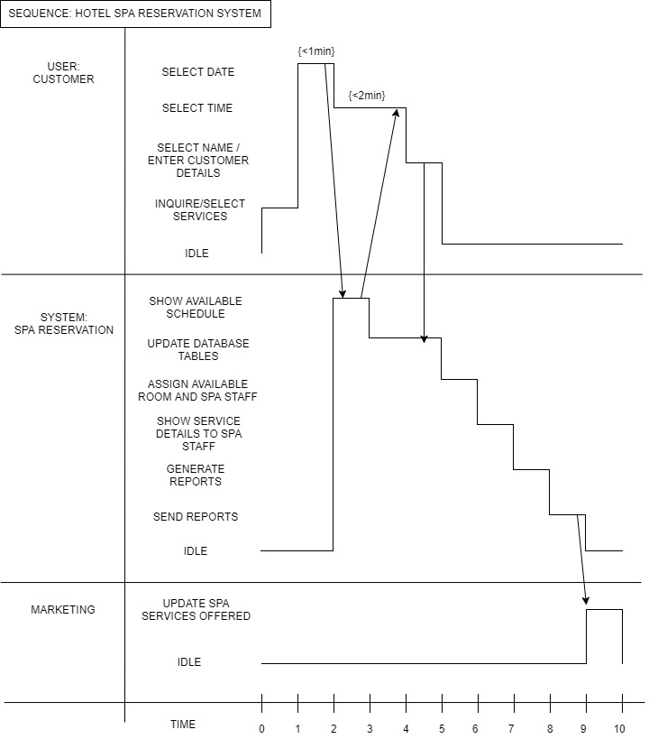
Timing Diagram

Slide 38
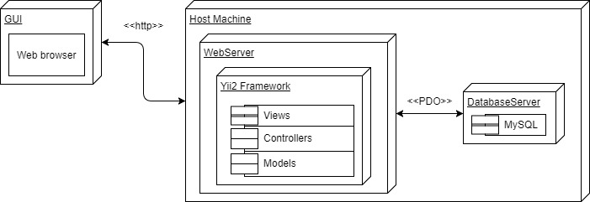
Deployment Diagram

Slide 39
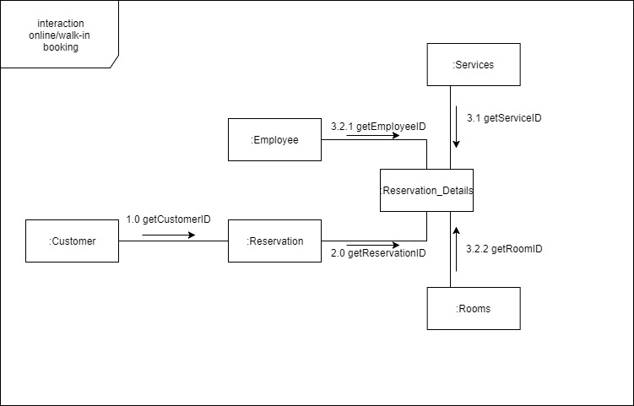
Communication Diagram

Slide 40
GAP ANALYSIS
User Requirements | Current Process | Proposed Changes
The system addresses/prevents the mistakes that occur from doing manual work processes. | All processes in the Asmara Spa is manual. In line with this, a lot of errors could occur. (e.g. lost appointments, wrong dates written on appointments) | The system will automate the process of booking a reservation and include an online reservation system for potential customers who are looking to book a reservation to the Asmara Spa via the internet.
To make the booking process more accessible | The booking process is a bit inconvenient because one way to make an appointment is through a third party website and none on their hotel website. | A web based system for customers who’d want to book a reservation but isn’t a guest checked-in at the hotel that will serve as an alternative.
To reduce the amount of time and resources needed in the booking process | In a manual work process, with errors occurring , a lot of time could be wasted fixing mistakes and it would require several people to do a certain task | The system aims to automate work processes so that less time and people are needed to complete a task.
To generate a report that would show spa trends | To see what trends, the spa has to review their list of reservations/bookings and manually tally the data enlisted in it. | The system will generate a report based from the data collected in the system’s database server, which will show how many reservations they had for the day, what is the most popular service, and what are the peak hours and days.

